Slide 1

Gingerfroth Soap (5/16/25)
Tallow 551.1
Castor oil 27.6
NaOH 78.0
Water 219.9
Fragrance 10
Gingerfroth Soap (5/16/25)
Tallow 551.1
Castor oil 27.6
NaOH 78.0
Water 219.9
Fragrance 10

Slide 2

G.O.A.T. Bar Soap (8/30/25)
Tallow 680
Castor oil 68
NaOH 100.4
Goat Milk 284.2
Fragrance 20
G.O.A.T. Bar Soap (8/30/25)
Tallow 680
Castor oil 68
NaOH 100.4
Goat Milk 284.2
Fragrance 20

Slide 3

Santa Duds Soap (9/4/25)
Tallow 186
Castor Oil 14
NaOH 26.9
Water 76
Red Mica IB002266 2
Autumn Fig 5
Harvest IB001207
Santa Duds Soap (9/4/25)
Tallow 186
Castor Oil 14
NaOH 26.9
Water 76
Red Mica IB002266 2
Autumn Fig 5
Harvest IB001207

Slide 4

Santa Suds (9/8/25)
Tallow 186
Castor Oil 14
NaOH 26.9
Water 76
Colored Mica 1
Titanium Dioxide 1
Christmas Splendor 5

Slide 5

Embeds: Beef Tallow CP soap with glitter enrobed in squid ink olive oil CP
Base: Olive Oil CP infused with annatto
Embeds: Beef Tallow CP soap with glitter enrobed in squid ink olive oil CP
Base: Olive Oil CP infused with annatto

Slide 6
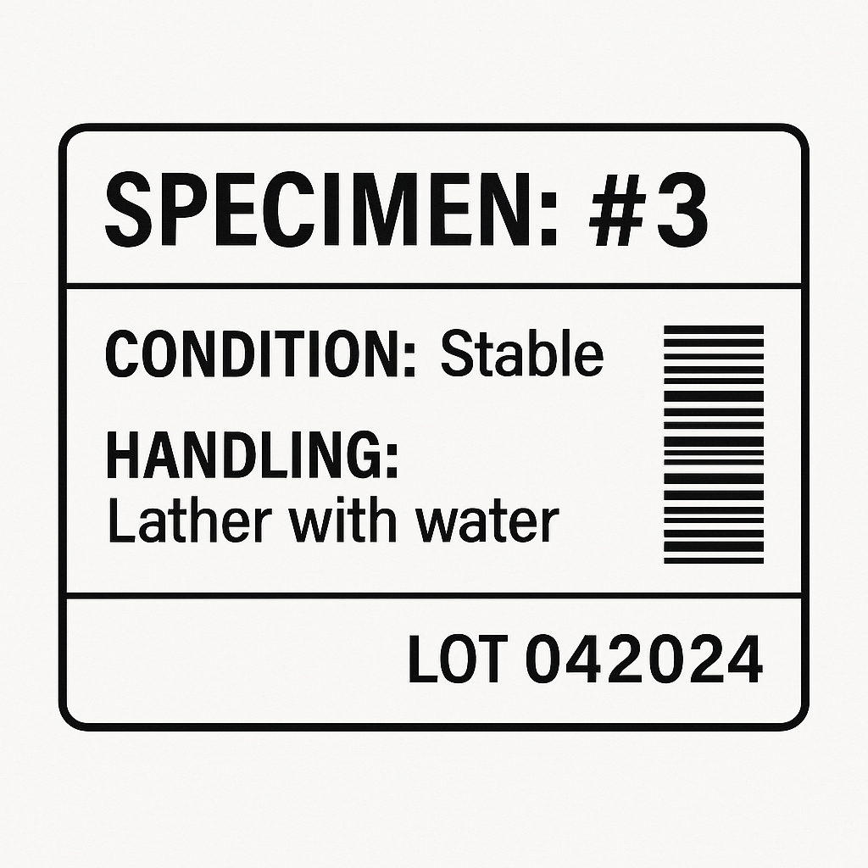
Beef Tallo 90%, Castor Oil 10% CP soap.
Blue circles: indigo
Brown border: cocoa
Base: tallow with castor oil infused with annatto
Beef Tallo 90%, Castor Oil 10% CP soap.
Blue circles: indigo
Brown border: cocoa
Base: tallow with castor oil infused with annatto

Slide 7

Beef Tallo 90%, Castor Oil 10% CP soap.
Embeds with cocoa
Beef Tallo 90%, Castor Oil 10% CP soap.
Embeds with cocoa

